Slide 1


WELCOME
PDSA PROJECT PRESENTATION

Slide 2




DAY
DREAMERS
LAHIRU
ASIRI

Slide 3


DAY
DREAMERS
INTRODUSHION
We have created this system to solve the problems in a car washing shop. There was no proper management because vehicles came to the shop in various ways. There we have solved the problems of management by using various data structures

Slide 4
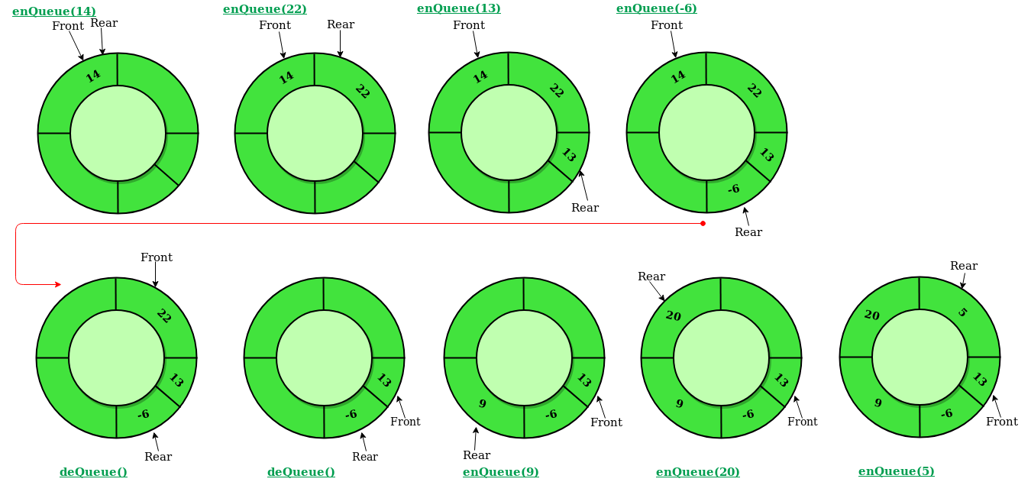
DAY
DREAMERS
Circular Queue

Slide 5
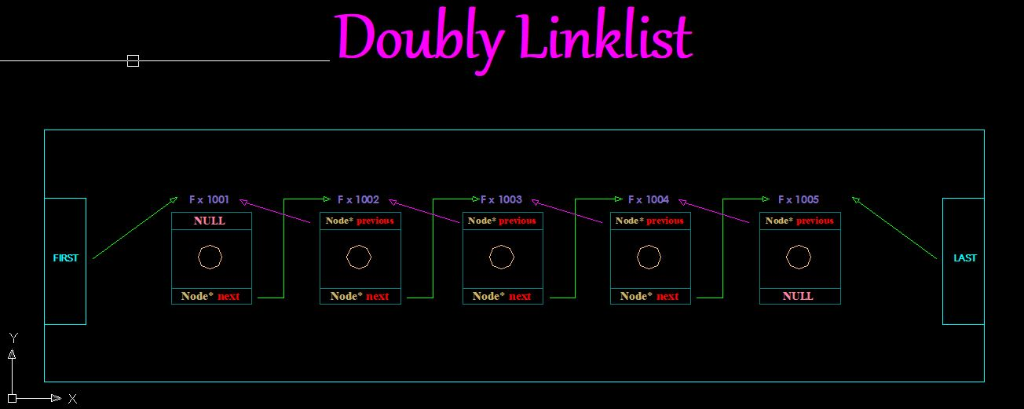
DAY
DREAMERS
Doubly LinkList

Slide 6
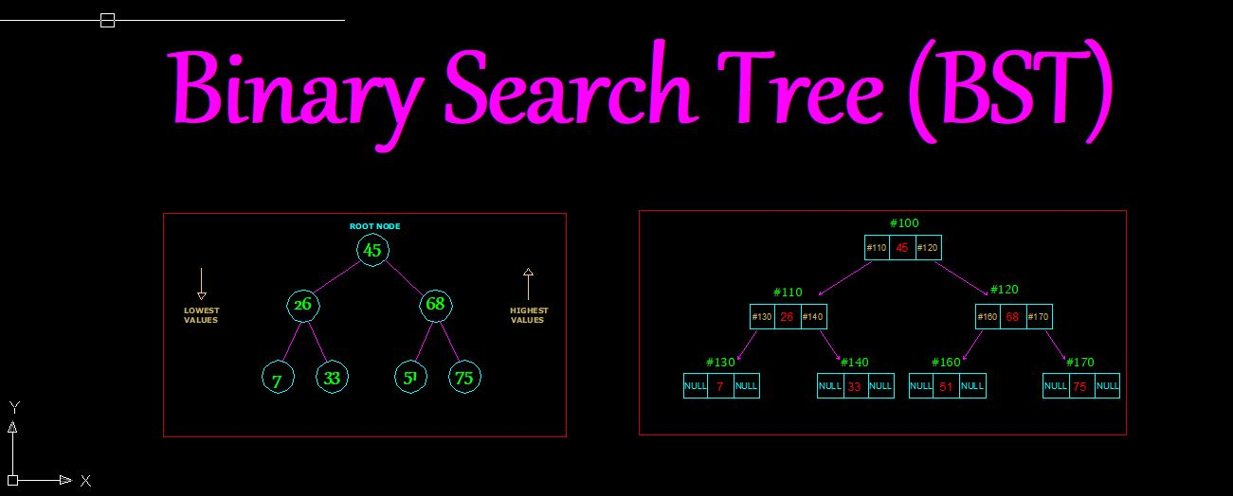
DAY
DREAMERS
Binary Search Tree

Slide 7

DAY
DREAMERS
Data Structures processing
This is a popular data structures in this application mange the real word vehicle queue in car washing center to allow them to engage with their washing capabilities acceding to first came first save approach. And it will allow to only stay 100 vehicle at a time.
Circular Queue

Slide 8
DAY
DREAMERS
Data Structures processing
This is also another data structures this is include this application to control the changing structure of the images and a text of the label to low , median , heavy vehicles. In the front car washing from in the UI.
Doubly LinkList

Slide 9
DAY
DREAMERS
Data Structures processing
Binary search tree is use in this application to enable affection searching operation by storing the data of particular vehicles according to their pate number in more organize manner.
Here there are three separate BST known as low BST, Median BST & Heavy BST to store the low weight vehicles, Median weight vehicles & heavy weight vehicles respectively.
Binary Search Tree

Slide 10

DAY
DREAMERS
T
H
A
N
K
Y
O
U
THANK YOU FOR THE ATTENTION

